Slide 1
Exploring Markers of Inequalities between Women and Men in Metropolitan and Overseas France
Phileas Dazeley Gaist – COA Data Science 1 – Fall 2021

Slide 2
Statement on Nomenclature
Gendered terms
Age groups
Socioprofessional designations
Metropolitan and Overseas France (DOM)

Slide 3

The data:
Net wage gap between men and women (2017) (%)
Formula = (w net hourly salary – m net hourly salary)/m net hourly salary
by: age groups, socioprofessional groups, total
Total rate of monetary poverty of individuals (2017) (%)
Intensity of poverty (2017) (%)
Differences in rates of employment of women and men in official positions in municipalities (2021) (%)
Differences in rates of average ages at first child between women and men (2019) (%)
Notes:
Describe the data sets (show that the formula means most values will be “how much % women are underpaid by when compared to men)
Describe source: INSEE and context of data collection
Two data set sources:
Indicateurs régionaux de développement durable (French regional sustainable development indicators) (INSEE, accessed 04/2021):
Indicateurs régionaux sur les inégalités entre les femmes et les hommes (French regional indicators on inequalities among women and men) (INSEE, accessed 05/2021)

Slide 4
Skip tables slide
Notes:
I gathered my data into 3 data frames based on the exploration and analysis I hoped to conduct
The variables of each tidied data frame

Slide 5
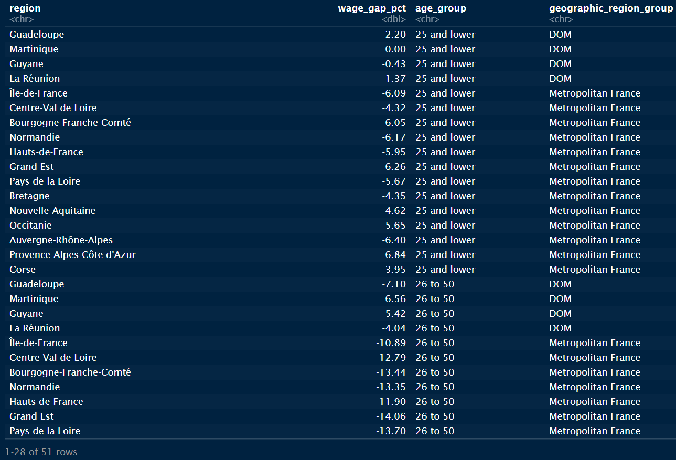
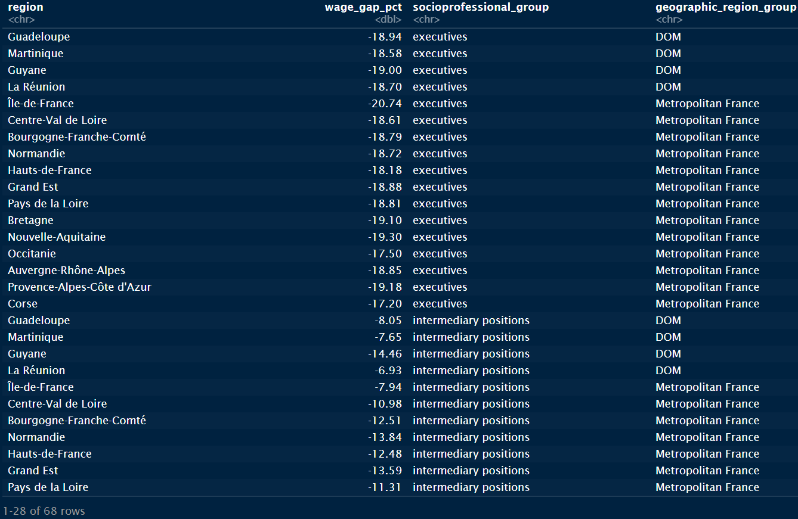
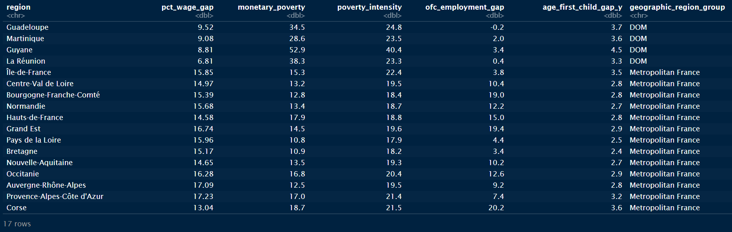

Slide 6
In summary, this project is an exploration of
Wage gap by age group and region
Wage gap by socioprofessional group and region
Ordination of observations of inequality-marker variables between women and men
Simple questions about my data sets

Slide 7
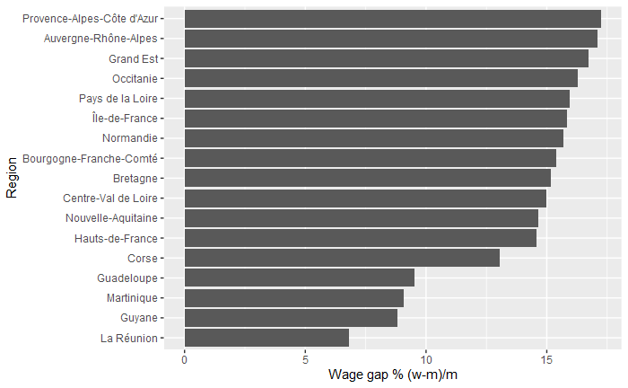
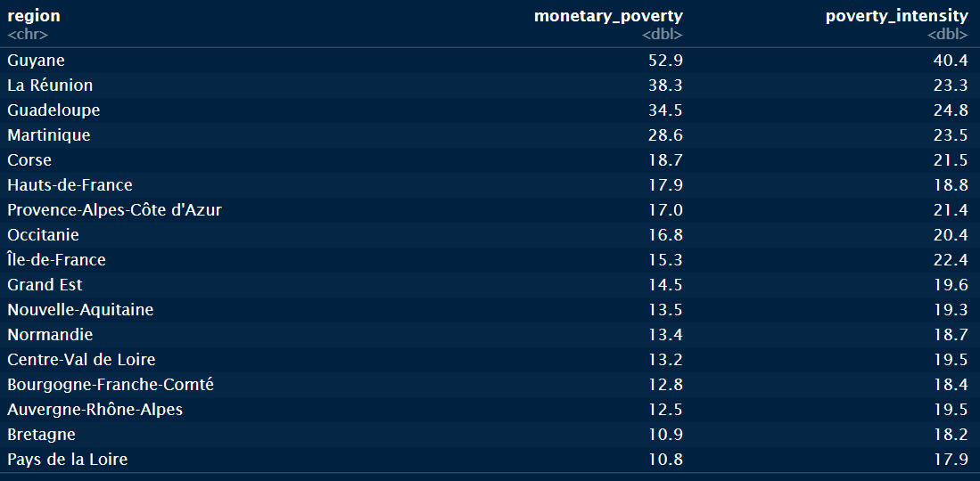
Data exploration:
In what regions of France was the wage gap between women and men the highest in 2017?
Which regions had the highest rates and intensities of poverty combined in 2017?
Notes:
For the data exploration part of this final, I formulated a few questions about the data and set out to answer them
I’m including 2 of them here

Slide 8
Two-way ANOVA tests:
Is there a difference in the recorded wage gap between women and men in different age groups in 2017 between metropolitan France and the DOM?
H0_1: there is no main effect of geographic region group
H0_2: there is no main effect of age group
H0_3: there is no interaction between geographic region group and age group
Notes:
I did two of these tests, but I will only present one here due to time constraints.
ANOVA = Analysis of variance: tests whether observations from within a group are more similar than individuals from different groups
Two-way ANOVA = when you have two categorical IVs (predictors) and one continuous DV (response)
Meeting two-way ANOVA assumptions:
Samples are independent
variances of data groups are approximately equal
it is safe to assume that each sample is taken from a normally distributed population

Slide 9
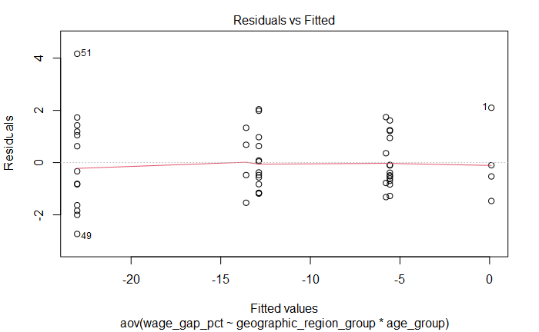
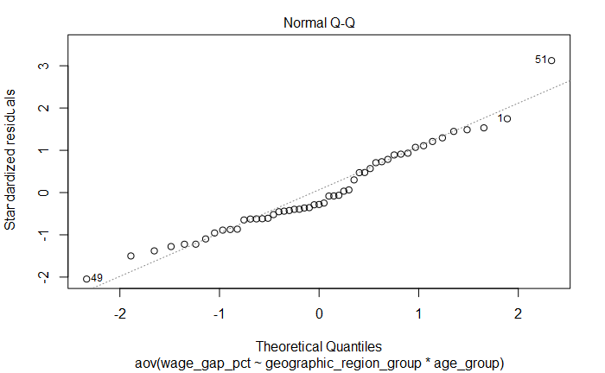
Meeting the assumptions of a two-way ANOVA test
Homogeneity of variance:
Normality:

Slide 10
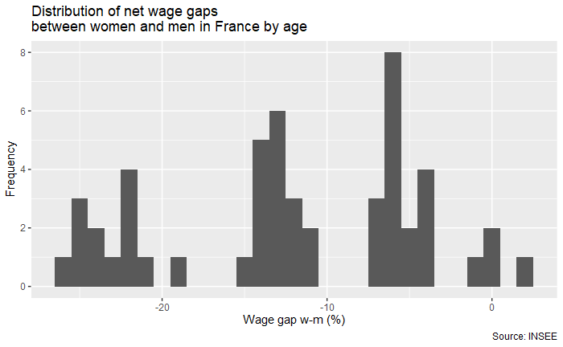
Notes:
Wage gap variable is sufficiently normally distributed

Slide 11
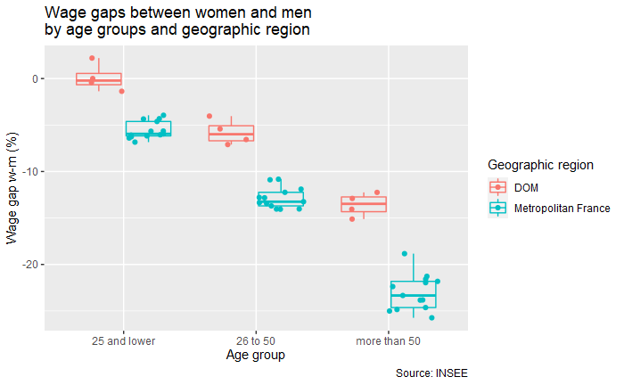
Notes:
- Homogeneity of variances in different groups
- Two apparent trends: wage gap is higher in metropolitan France, and wage gap is higher in older age groups, highest in the above 50 category

Slide 12
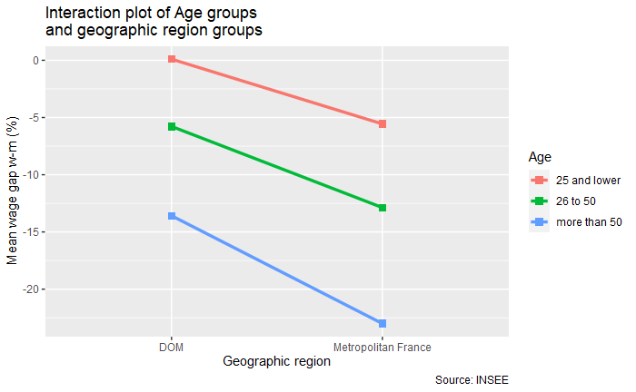
Notes:
On this interaction plot, there is no apparent interaction between variables
(possible exponential interaction = line slopes differ)

Slide 13
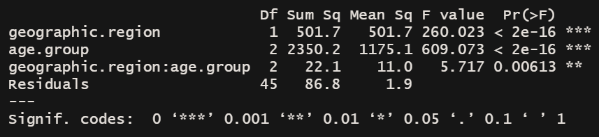
Results:
A two-way ANOVA (table above) revealed a significant effect of geographic region (P < 0.01) and age group (P < 0.01) on wage gap % between women and men, but with a significant interaction between geographic region and age group (P < 0.01). Observations in age group age>50 in Metropolitan France yielded higher wage gap results than expected when compared to the values found in other age group observations. We can reject H0_3 but require further research in order to support or reject H0_1 and H0_2.
Notes:
# Null hypotheses:
# H0_1: there is no main effect of factor A
# H0_2: there is no main effect of factor B
# H0_3: there is no interaction between factors A and B (rejected)
Not going to go into too much detail about the TukeyHSD test results because of limited time + it’s a bit excessive

Slide 14
Ordination of inequality-marker variables between women and men for regional observations in Metropolitan France and the DOM
(An NMDS approach)
Notes:
Observations = regions
Inequality marker variables = age at first child gap, wage gap, employment gap in official positions in municipalities, rate of monetary poverty, intensity of poverty

Slide 15
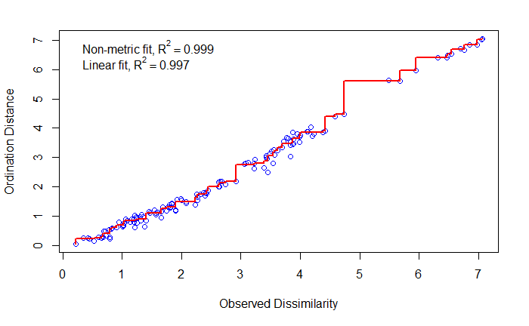
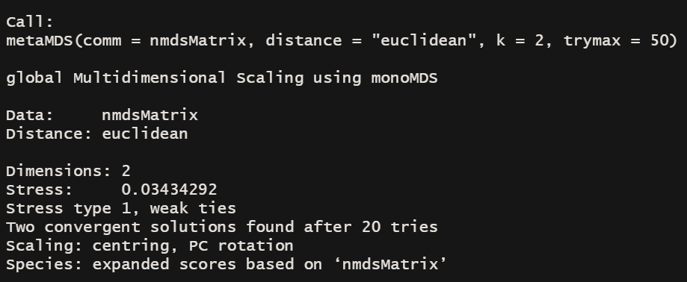
Notes:
NMDS method used = vegan library metaMDS (good for non biological data ordinations)
Two NMDS dimensions in ordination space
Stress = 0.03 (quite good, appropriate for test)
Goodness of fit in Shepards diagram – pretty exceptionally well fitted

Slide 16
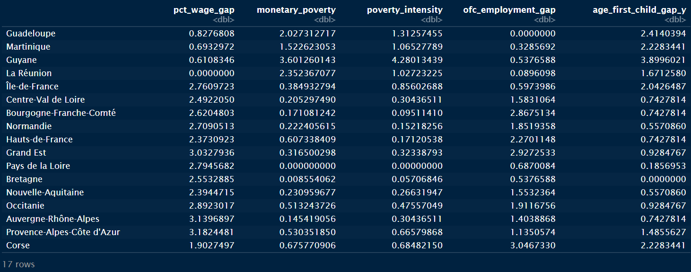

Slide 17
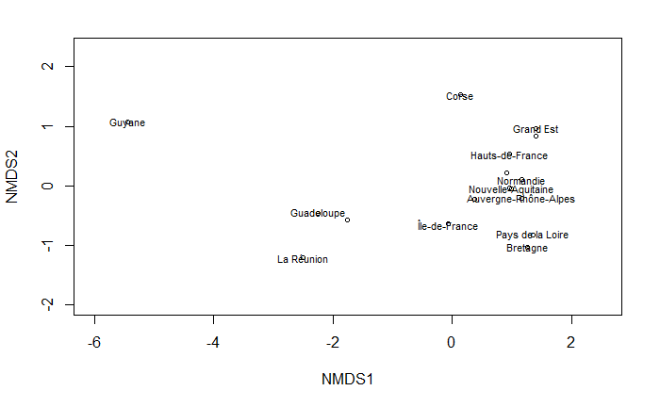
Notes:
A plot of individual regions in ordination space:
You can see that negative values of NMDS1 are associated with DOM observations while positive values of NMDS1 are associated with metropolitan France
The associations between the observations and NMDS2 are not as immediately clear

Slide 18
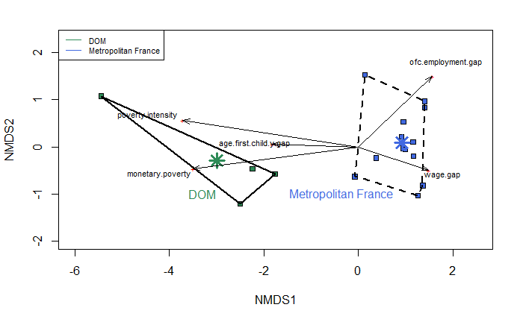
Notes:
In this ordination plot
Observations are color coded based on geographic region (DOM vs Metropolitan France)
DOM and Metropolitan France group centroids plotted as stars, and convex hulls around geographic region group point clusters
Variable scores vectors
NMDS1 negative = association to DOM, higher monetary poverty, age at first child gap, and instensity of poverty
NMDS1 positive = association to MET, higher wage gap %, higher employment gap % in official positions
NMDS2 positive = association to higher employment gap, suggests variation among metropolitan france group

Slide 19
Bibliography:
“Data Analysis in the Geosciences.” Accessed November 14, 2021. http://strata.uga.edu/8370/lecturenotes/multidimensionalScaling.html.
“Définition - Intensité de La Pauvreté | Insee.” Accessed November 14, 2021. https://www.insee.fr/fr/metadonnees/definition/c2021.
Matthew E. Clapham. 29: Non-Metric Multidimensional Scaling (NMDS), 2016. https://www.youtube.com/watch?v=Kl49qI3XJKY.
sample(ECOLOGY). “NMDS Tutorial in R,” October 24, 2012. https://jonlefcheck.net/2012/10/24/nmds-tutorial-in-r/.
“Pauvreté − France, Portrait Social | Insee.” Accessed November 14, 2021. https://www.insee.fr/fr/statistiques/4238395?sommaire=4238781.
Plot and GGPlot in R | Applied Math Bytes says. “Plot Ranges of Data in R.” Burns Statistics, February 21, 2013. https://www.burns-stat.com/plot-ranges-of-data-in-r/.
R packages used: tidyverse, broom, PerformanceAnalytics, Hmisc, ggpubr, vegan, robustHD

